Slide 1
Jamestown Safe, Healthy, and Equitable Streets Improvement Project Supplemental Project Initiation Document (PID) Report
Tuolumne County Transportation Council
2/8/23

Slide 2
Purpose of Supplemental Project Initiation Document
First PID completed in October of 2020
Concerns over the portrayal of the project, as described in this initial PID, arose shortly after.
Supplemental PID was embarked upon in January, 2022 with a focus on ensuring the document recognized the project’s focus on serving all users.

Slide 3
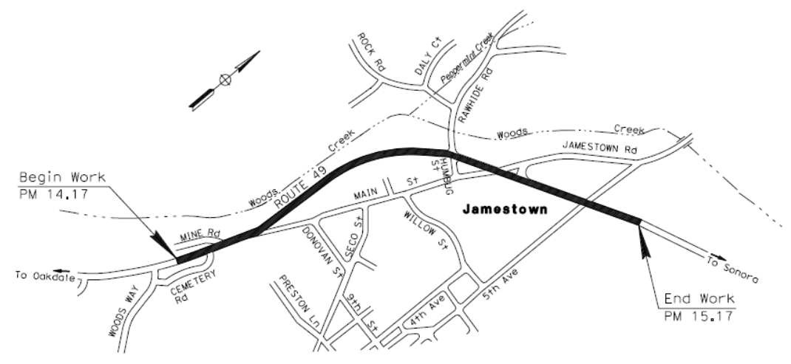
1 Mile Segment of SR 49 Near Jamestown
Project Overview
Roadway and Traffic Signal Improvements
Transit Stops
Park and Ride Facility
Sidewalks
Bicycle Facilities
Source: Caltrans Supplemental PSR-PDS

Slide 4
What was included in the Supplemental PID?
Change in narration to ensure corridor challenges and solutions to those challenges provided by the project were recognized
The addition of a new, third alternative with no additional lanes and only operational improvements
An additional comparative traffic analysis as a traffic consultant for TCTC, including a detailed VMT analysis that was prepared for each alternative, was included in the Supplemental PID
A Supplemental Traffic Engineering Performance Assessment (TEPA)
Economic Analysis of each alternative
Source: Caltrans Supplemental PSR-PDS

Slide 5
Overview of Alternatives
Alternative 1: 5-Lane SR 49.
Widen both sides of highway.
Alternative 2: 5-Lane SR 49.
Widen on the west side of highway only.
Alternative 3: 3-Lane SR 49.
Operational improvements at intersections.
*Note: All alternatives include multimodal improvements including sidewalks, bike lanes, transit stopes, and a Park and Ride with ZEV chargers

Slide 6
Description of Alternatives
No build
This assumes no improvements over existing conditions. Additionally, over time, existing conditions could become worse.
Alternative 1 & 2 Estimated Cost: $18,950,000 or $19,588,000
Assumes the following improvements are constructed:
Widening SR 49 from 3 lanes to 5 lanes near Jamestown
New transit stops, bike lanes, and sidewalks.
Jamestown Park & Ride lot
A new northbound right turn pocket at Main Street
Rawhide Road Bridge Project, inclusive of roadway geometric changes on Jamestown road and Main Street.
Gold Rush Shared Use Path Project and associated improvements and programs (i.e., E-bike and E-scooter share program).
Alternative 3 Estimated Cost: $16,775,000
This assumes all the same improvements are constructed as Alternatives 1 & 2 except that it does not include widening SR 49 from 3 lanes to 5 lanes near Jamestown and, instead, includes operational improvements on SR 49 such as turn lanes, signal coordination, and additional storage.

Slide 7
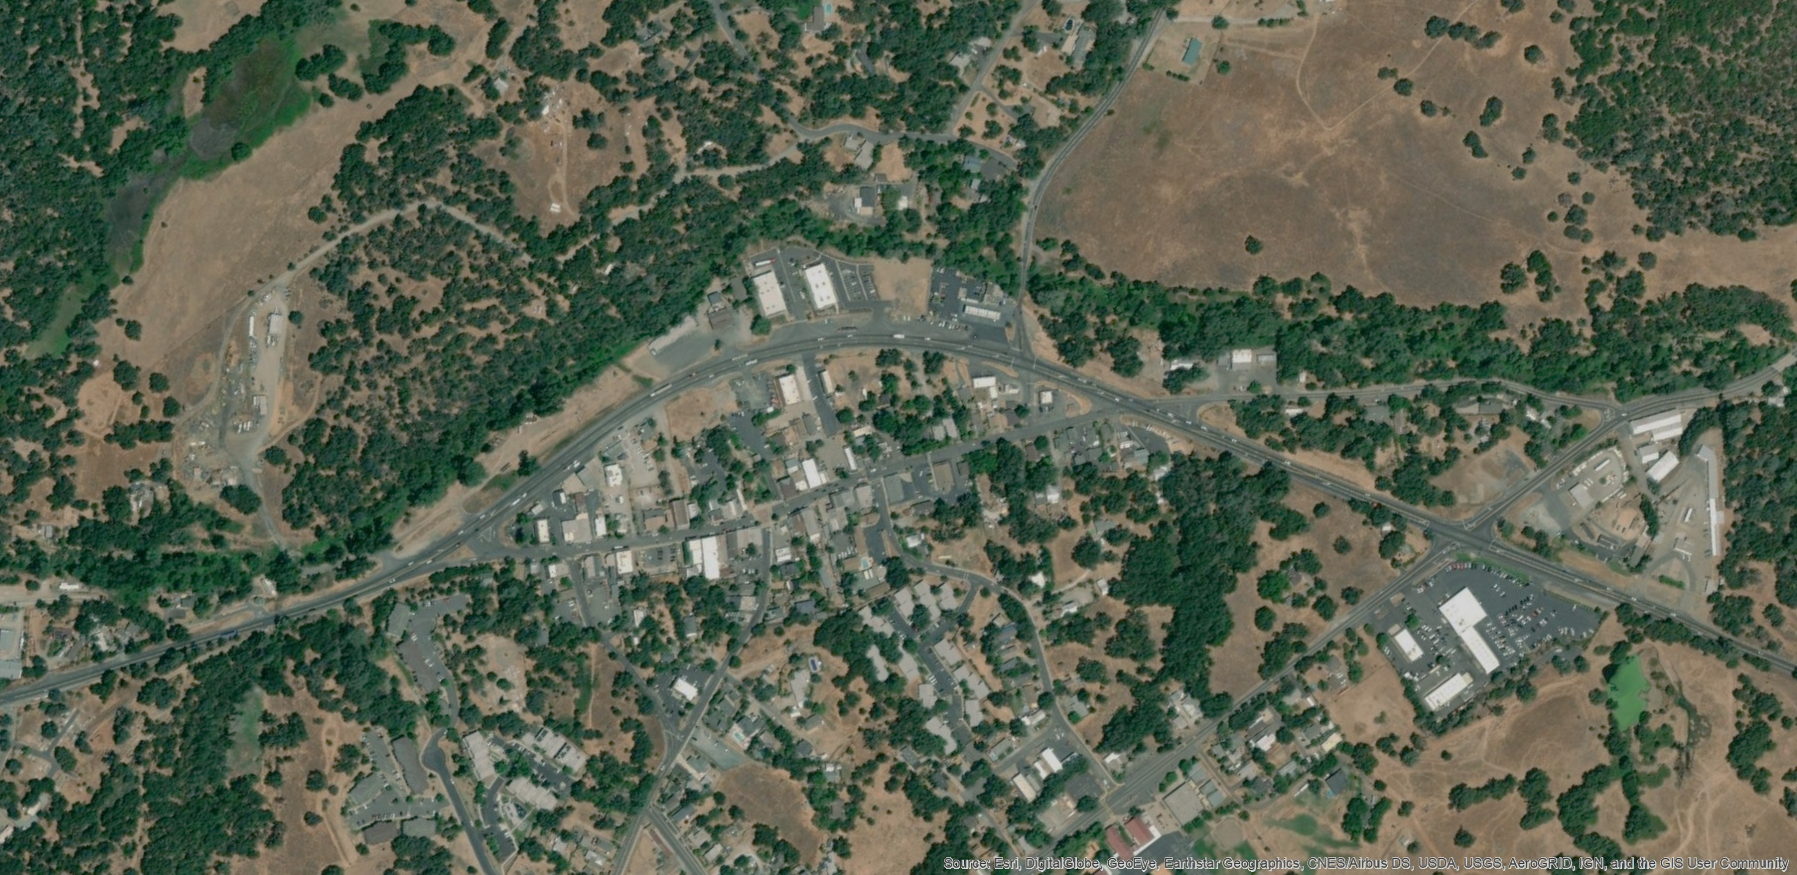
Alternative 1 & 2
N
Proposed Park and Ride Location
2 Transit Stops Locations TBD
Rawhide Rd
Realigned Rawhide Rd
5 Lane Highway with Bicycle Lanes & Sidewalks on Both Sides
Jamestown Rd
2
SR 49
Fifth Ave
Main St
3
1
SR 49
Fifth Ave
Proposed New Turn Lanes
= Project Intersections
#

Slide 8
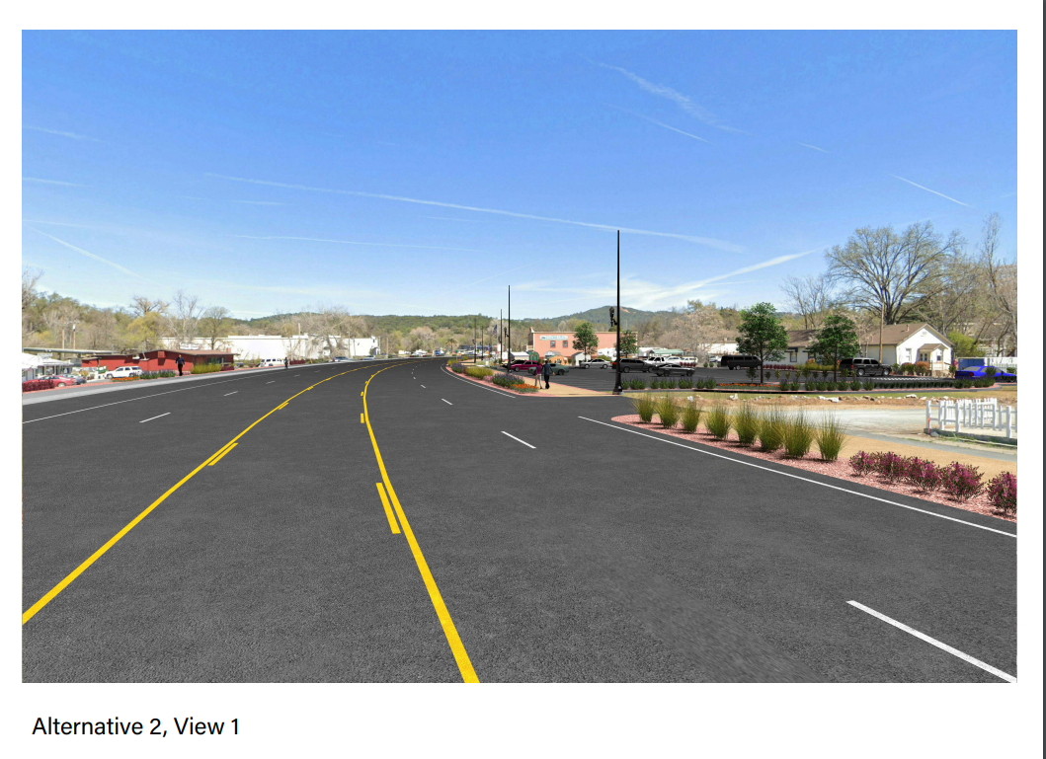
Alternative 1 & 2

Slide 9
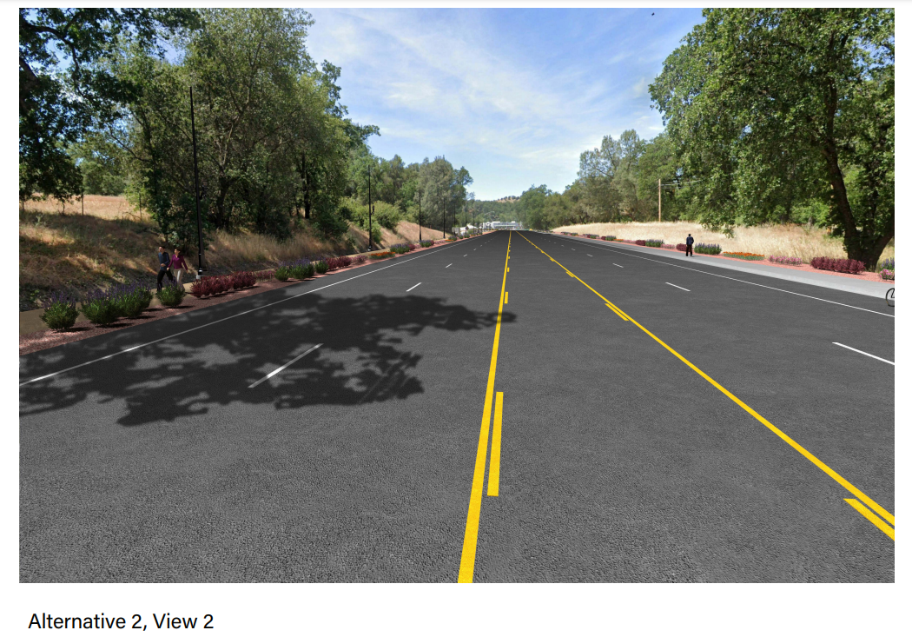
Alternative 1 & 2

Slide 10
Alternative 3
N
Proposed Park and Ride Location
2 Transit Stops Locations TBD
Rawhide Rd
Realigned Rawhide Rd
3 Lane Highway with Bicycle Lanes. Sidewalk on West Side. Class I Path on East Side
Jamestown Rd
2
New Signal
& Coordinate
Fifth Ave
SR 49
Main St
3
1
SR 49
Fifth Ave
Proposed New Turn Lanes
= Project Intersections
#

Slide 11
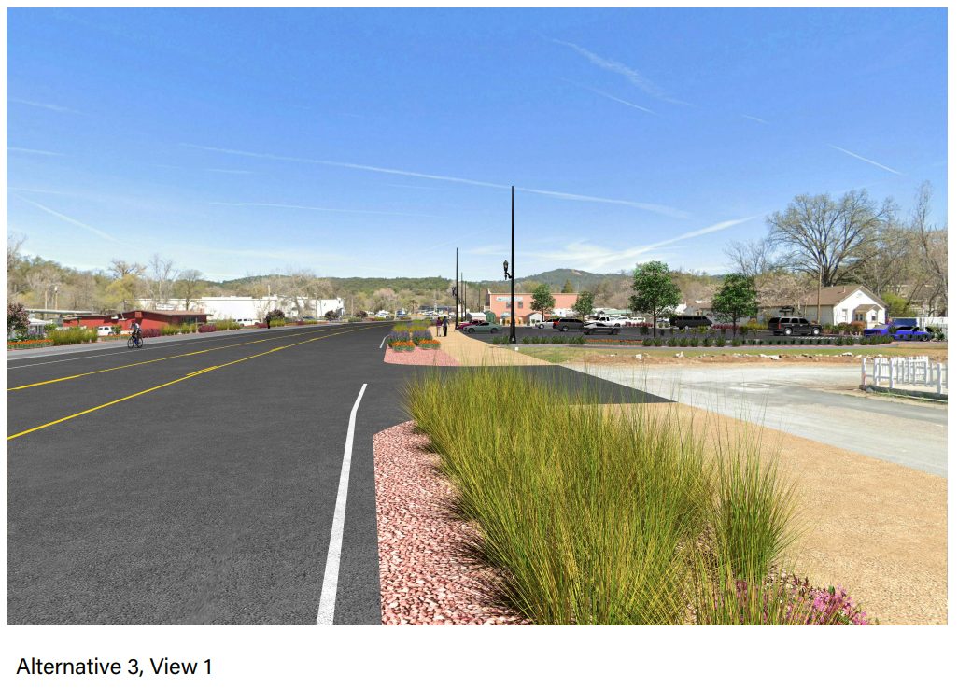
Alternative 3

Slide 12
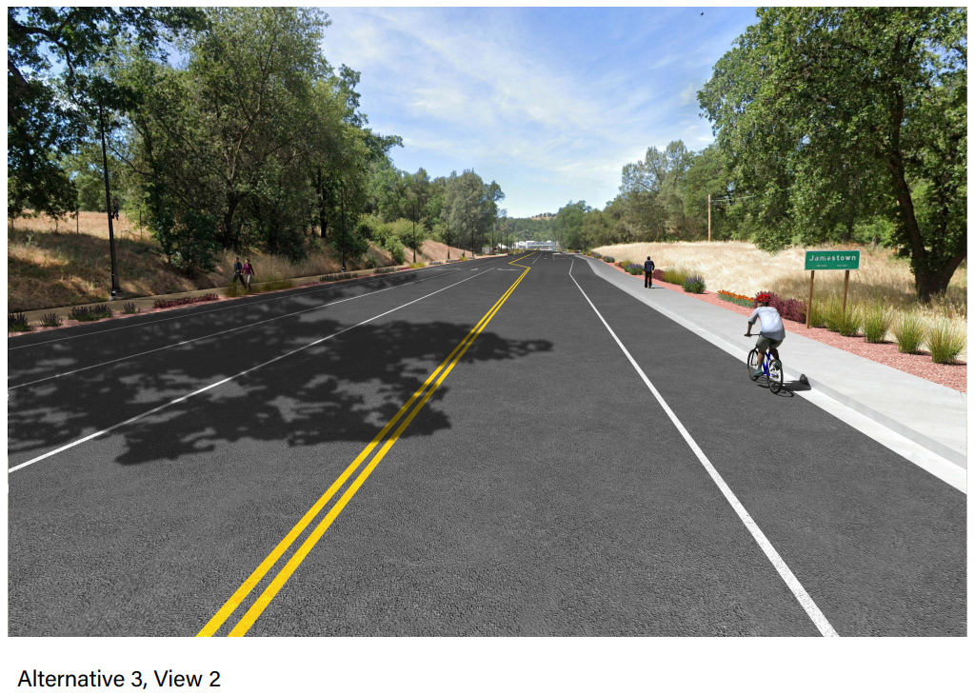
Alternative 3

Slide 13
Other Study Area Projects
Rawhide Road Bridge Project
New bridge and realignment of Rawhide Road to the east.
Gold Rush Shared Use Path Project and E-Bike/E-Scooter Program
Class I shared use path between Chicken Ranch Road and Columbia College.

Slide 14
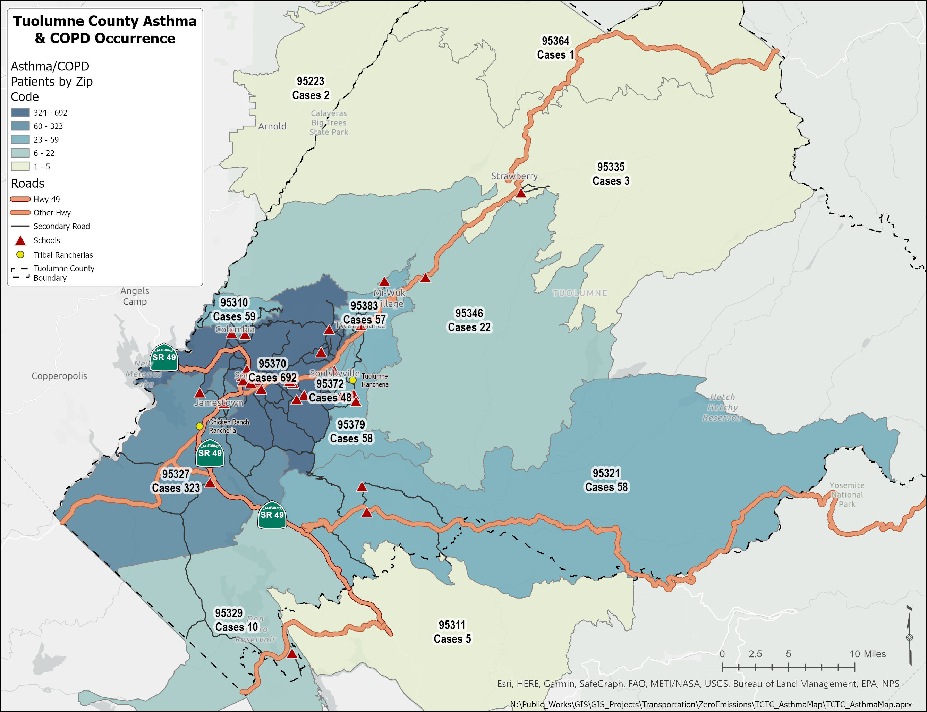
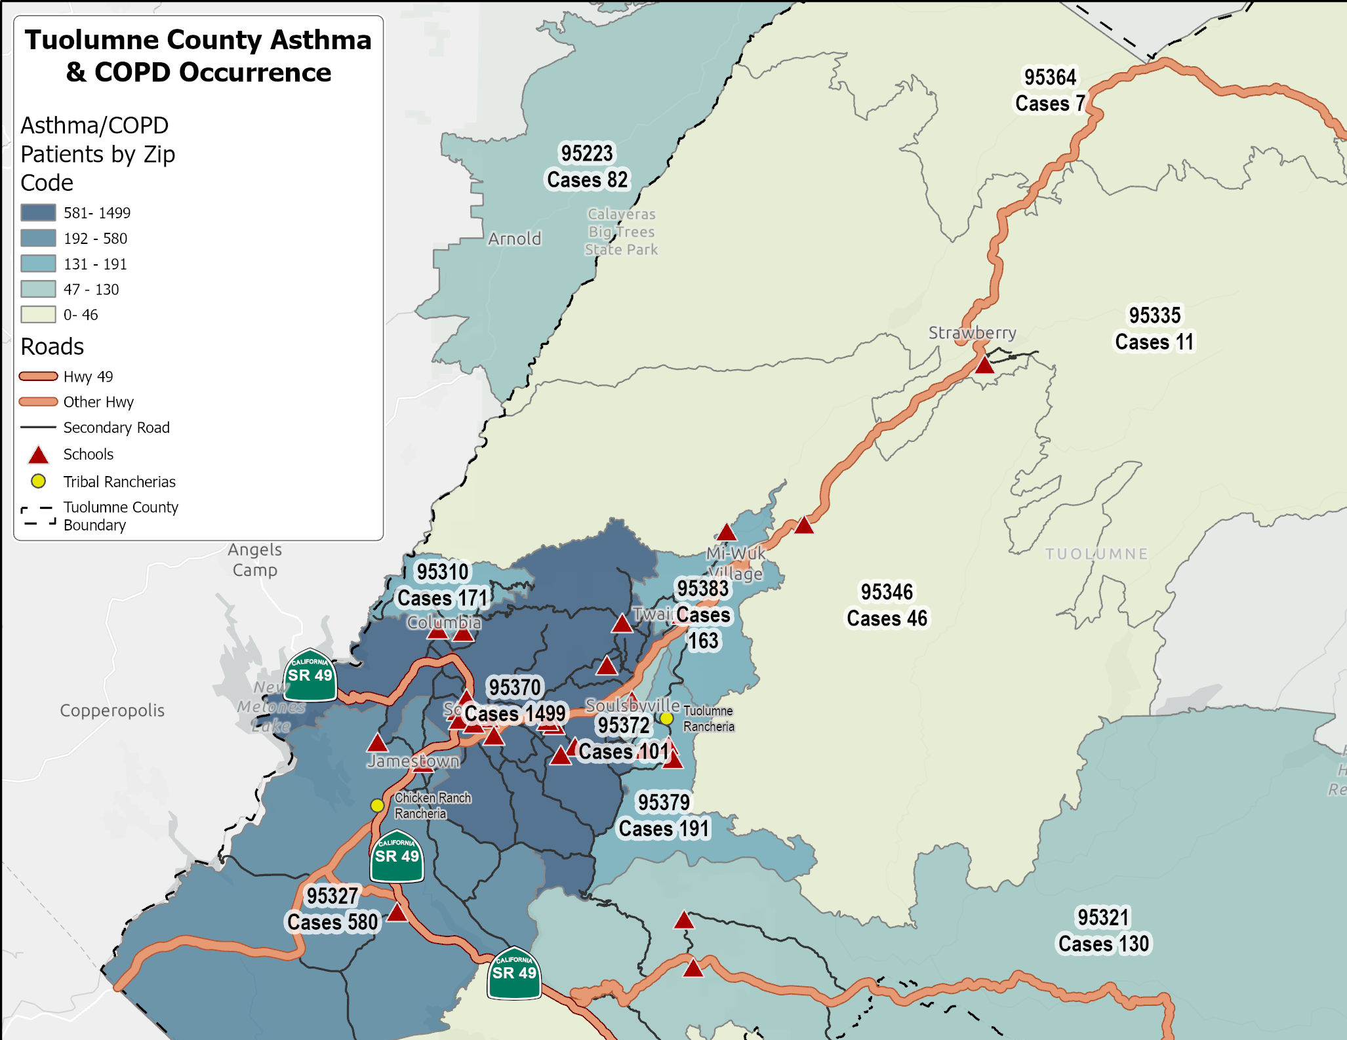
Health
Asthma & COPD
This map shows Asthma and COPD patients by zip code and notes schools in red triangles and Tribal Rancharias as yellow circles.
Sensitive receptors are potentially impacted by vehicle emissions on SR 49

Slide 15
Emissions
Design Year 2047 Project Effects on County Emissions (metric tons CO₂E) | Design Year 2047 Effects on County VMT
Value | Alt 1 & 2 | Alt 3
Tuolumne County Emissions under No Build | 314,712 | 314,712
Total Change in Tuolumne County Emissions Due to VMT under Project Alternative | -1,127 | -1,645
Total Change in Tuolumne County Emissions Due to Congestion under Project Alternative | -1,735 | -1,179
Tuolumne County Emissions under Project Alternative | 311,850 | 311,888
Percent Change in Tuolumne County Emissions under Project Alternative | -0.91% | -0.90%

Slide 16
Improve Access: To government services in Sonora, shopping, childcare, higher education, healthcare, and recreation in the county through pedestrian, cyclist, and transit improvements as well as a Park & Ride facility.
Support the Local Economy: By enhancing access to job training and employment opportunities as well as nearby grocery stores and other retail facilities.
Equity
Improve community health: With pedestrian and cyclist improvements the project will help create a connected community which encourages multimodal transportation utilization, a healthy community lifestyle, and improve access to health care facilities.

Slide 17
Support Infill Development: By facilitating development within the Jamestown community through infrastructure investments.
→ Focusing future grown on infill areas within existing communities helps protect natural and agricultural land from future development and is compliant with CAPTI. The SR 49 Corridor between Jamestown and Sonora has very low VMT per capita.
Climate Action
Reduce Vehicle Miles Traveled: Through pedestrian and cyclist facility improvements or construction as well as the addition of a sheltered Park & Ride. Jamestown already has among the lowest VMT in the County. Encouraging growth will reduce, overall, future VMT in the region.
Support ZEV Integration: Jamestown is expected to host Electric Vehicle Chargers at the Park & Ride.
Reduce the Impact and Concentration of GHG Emissions: On the environment and nearby vulnerable populations and Jamestown Elementary

Slide 18
Vehicle Miles Traveled (VMT)
Design Year 2047 Project Effects on County VMT | Design Year 2047 Effects on County VMT
Value | Alt 1 & 2 | Alt 3
Tuolumne County VMT under No Build | 2,166,395 | 2,166,395
Change in VMT due to the SR 49 Multimodal Improvements (Sidewalks, Bike Lanes, Bus Stops) | -1,237 | -1,237
Change in VMT due to the Park-and-Ride Lot | -1,419 | -1,419
Change in VMT due to the SR 49 Widening | +3,563 | 0
Change in VMT due to the Rawhide Road Bridge Project | -642 | -642
Change in VMT due to the Gold Rush Shared Use Path and E-Bike/Scooter Program | -8,023 | -8,023
Total Change in Tuolumne County VMT under Project Alternative | -7,758 | -11,321
Tuolumne County VMT under Project Alternative | 2,158,637 | 2,155,074
Percent Change in Tuolumne County VMT under Project Alternative | -0.36% | -0.52%
*VMT analysis includes complete construction of Gold Rush Shared Use Path and growth centered in infill areas along the SR 49 corridor.

Slide 19
“Fix-it-first”: Non-existent, or inadequate, pedestrian bicycle and transit facilities will be constructed or improved.
→ This reduces the instances of pedestrian and cyclist fatalities and injuries which aligns with Caltrans’ “Safe System” approach and their vision for zero fatalities and serious injuries.
→ The goal is to reduce accident rates to average or below statewide rates.
Safety
Improve Climate Change Resiliency: Planned improvements and operational emergency strategies should be consistent with the Tuolumne County Emergency Evacuation Strategies Report. This project includes the option to add lanes which would improve evacuation efforts.
→ Though “capacity increasing”, lane additions would improve resiliency in a rural community with a significant low-income population that does not have the evacuation resources, and existing capacity of larger communities. This reduction of impact is supported in CAPTI.

Slide 20
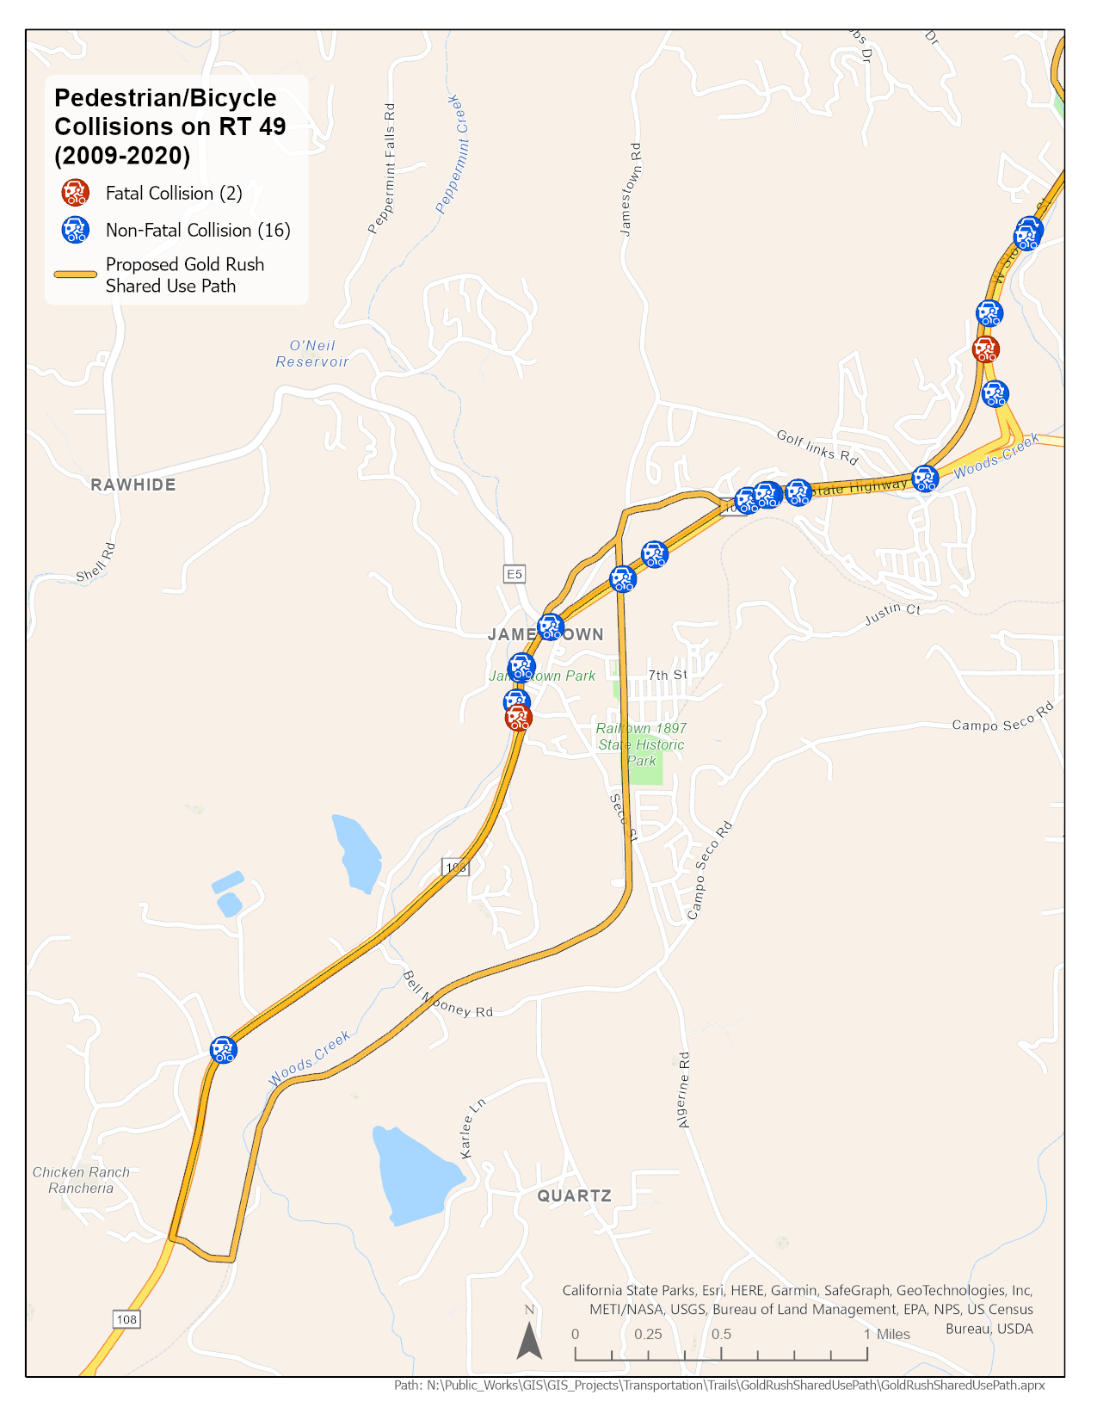
Safety
Existing Conditions

Slide 21
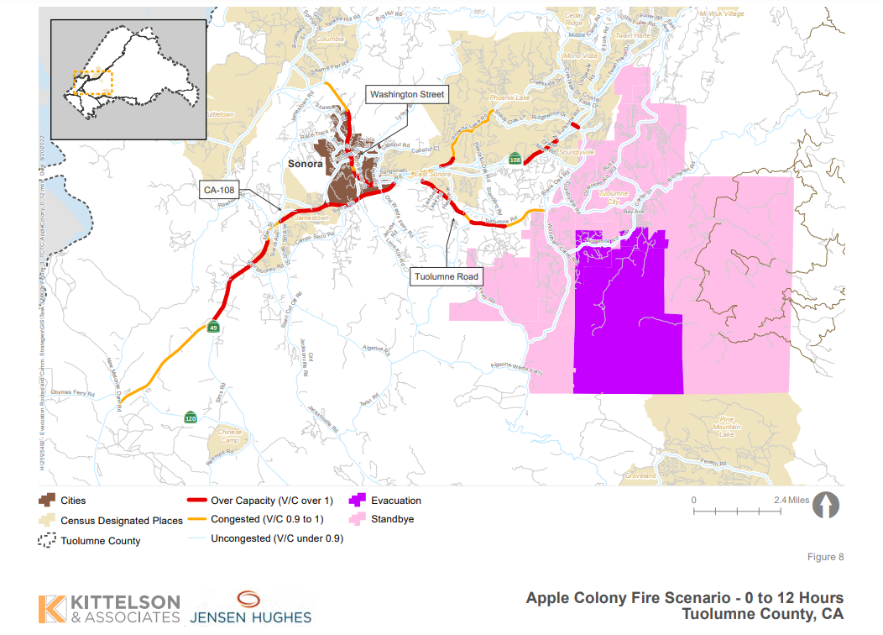
Safety
Initial findings from the Tuolumne County Emergency Evacuation Strategies Report, an example included here, show that our major highways will exceed capacity in a larger evacuation. Our Climate Change Resiliency efforts will need to include capacity increasing projects.
Notes:
The modeling has limitations due to the fact that fires are incredibly variable things. The primary thing I want to illustrate with this slide (and the next one) is that we clearly need more capacity on our major freeways to ensure an efficient larger evacuation of the county.

Slide 22
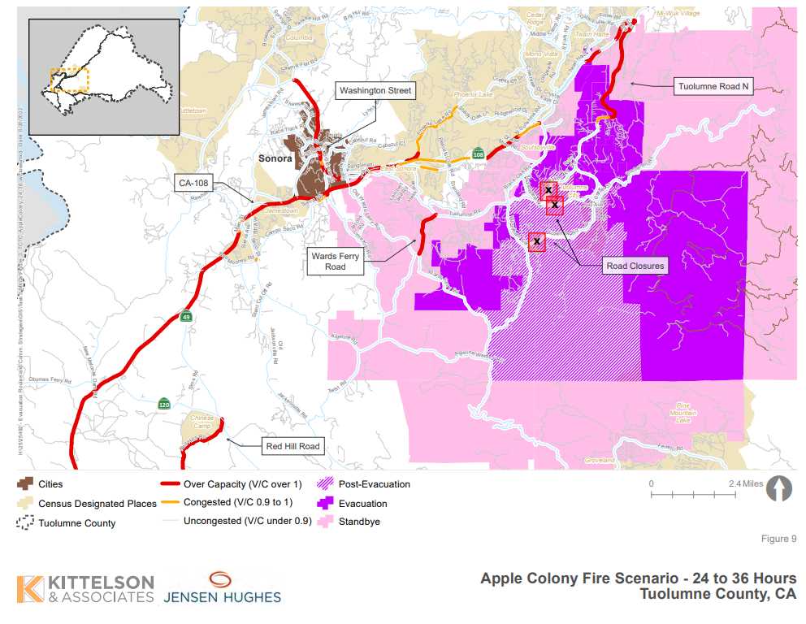
Safety

Slide 23
Additional Consideration: Caltrans Evacuation Route Design Guidance- Design Information Bulletin 93
Came about as a result of increased number of wildfire events in rural communities with primarily one major route of ingress and egress.
States that projects on evacuation routes in areas such as ours be carefully considered so as to ensure the preservation of our major evacuation route/s.
If no widening occurs, as defined in Alternatives 1 and 2, it may be beneficial to consider widening the road to improve evacuation capacity in other ways such as with a truck lanes, transit lanes, or wide shoulders.
Such supplemental alternative widening options would be further explored in the PA&ED phase

Slide 24
Next Steps: Alternative Analysis
Purpose Category | No build | Alt 1 & 2 | Alt 3
“Fix-It-First”, Safety, and rear-end collision reduction. | - | ++ | +
Climate Change Resiliency & Evacuation Efficiency Improvements | - | +
Improves Access | - | + | +
Supports the Local Economy | - | + | +
Improves Community Health | - | + | +
Support Infill Development | - | + | +
Encourages ZEV Implementation | - | + | +
Reduce Vehicle Miles Traveled | - | + | +
Reduce GHG Emissions | - | ++ | +
Reduces Traffic Congestion | - | +
Notes:
1) Due to potential roadway narrowing, Alternative 3 may impact evacuations. This might warrant further study during PA & ED if chosen.
2) Improves bike/ped safety and reduces rear-end collisions
3) Multi-modal improvements plus traffic congestion relief benefits emission reductions.
Index
“-” = Possible negative impact
“O” = No change
“+” = Positive Impact

Slide 25
Next Steps:
Obtain funding for the PA & ED Phase
One option is to apply the project for consideration to the Caltrans System Investment Strategy, or CSIS, which is a program designed to nominate the best projects that include multimodal transportation options to expand mode choices and reduce transportation-related emissions.

